Slide 1

STRATEGIC PLANNING MEETING
2026-2027
One mission. Three pillars. Measurable community impact.
TZL COMMUNITY & EDUCATION INITIATIVE
BUILD LEADERS | STRENGTHEN FAMILIES | EMPOWER COMMUNITIES
Program Year: August 1, 2026 - July 31, 2027
Notes:
Open by framing TZL CEI as the chapter's connected community-impact system. The purpose is to make the full operating model understandable before discussing commitments and decisions.
[Sources]
- TZL CEI Strategic Plan 2026-2027 Presentation Community Benefit Scorecard.pptx (attached)
- https://tzlcei.org/
[/Sources]

Slide 2




ORGANIZATIONAL HISTORY
TZL Community & Education Initiative
2026
Building Leaders. Strengthening Families. Empowering Communities.
Foundation for Community Impact
Inaugural Board Members
Key Contributors
TZL CEI was established to provide a strong, sustainable foundation for community service connected to Alpha Phi Alpha Fraternity, Inc., Theta Zeta Lambda Chapter.
Founder
Inaugural Role
Leland Walker
Mikehl Hafner
Jeanice Townsend
Matthew Coats
Founding President
Ramone Crowe
Founding Vice President
Guidance and support that strengthened TZL CEI during its early development.
The organization grew from longstanding Chapter work in youth mentoring, education, family support, literacy, civic engagement, scholarships, and community service throughout Washtenaw County.
Lyonel Milton
Founding Secretary
Lemar Thomas
Founding Treasurer
Dr. Darrell Hudson
Founding Board Member
Signature Programs Today
Clif Flowers
Founding Board Member
ELMP
Lawrence Hood
Founding Board Member
Mentoring, leadership, academic support, and service.
10 + 3
10 inaugural board members
3 key contributors
Dr. Sarena Shivers
Founding Board Member
Caring & Sharing
Tamika Jones
Founding Board Member
Food, essentials, referrals, and partnerships.
Together, they established the mission, governance structure, financial systems, oversight, and strategic direction.
Dr. Todd Ester
Founding Board Member
TZL Empower
Board charge: responsible leadership, accountability, service, and partnership.
Nonpartisan civic education and engagement.
An enduring community institution built on responsible leadership, accountability, service, and partnership.
TZL CEI | 2026–2027 Strategic Planning
Notes:
TZL CEI was established to provide a strong and sustainable foundation for community service connected to Alpha Phi Alpha Fraternity, Inc., Theta Zeta Lambda Chapter. The organization grew from the Chapter's longstanding work in youth mentoring, education, family support, literacy, civic engagement, scholarships, and community service throughout Washtenaw County. Inaugural Executive Board: Matthew Coats, Ramone Crowe, Lyonel Milton, Lemar Thomas, Dr. Darrell Hudson, Clif Flowers, Lawrence Hood, Dr. Sarena Shivers, Tamika Jones, and Dr. Todd Ester. Key contributors: Leland Walker, Mikehl Hafner, and Jeanice Townsend. Together, the founders established the organization's mission, governance structure, financial systems, program oversight, and strategic direction.

Slide 3
CONNECTED IMPACT MODEL
Three pillars deliver Alpha's National Programs locally
Alpha's four National Programs are mandated for chapter implementation; TZL CEI organizes that work through the three existing pillars rather than creating parallel programs.
BUILD LEADERS
STRENGTHEN FAMILIES
EMPOWER COMMUNITIES
ELMP develops knowledge, character, academic readiness, career exposure, and leadership practice.
Caring & Sharing provides dignified, practical care and sustained connection to Brothers, widows, families, and elders.
TZL Empower builds civic knowledge, community voice, nonpartisan participation, and local leadership.
NATIONAL ALIGNMENT
Go-to-High-School, Go-to-College • Project Alpha™
NATIONAL ALIGNMENT
A. Charles Haston Brother’s Keeper
NATIONAL ALIGNMENT
A Voteless People is a Hopeless People (VPHP)
LEARN > SERVE > ENGAGE > REFLECT > LEAD
TZL COMMUNITY & EDUCATION INITIATIVE | 2026-2027
3
Notes:
Emphasize that CEI is the umbrella and the three signature programs are integrated. Every 2026-2027 Esquire is expected to encounter all three pillars through learning, service, civic engagement, reflection, and leadership.
[Sources]
- Version 6 ELMP Information Packet(1).pdf (attached)
- Caring_and_Sharing_2026-2027_Information_Packet.pdf (attached)
- TZL_Empower_2026-2027_Information_Packet(1).pdf (attached)
- https://tzlcei.org/
- https://a2esquires.org/
- https://tzlcaringsharing.org/
- https://tzlempower.org/
[/Sources]

Slide 4
PLANNING BASIS | 2025–2026 BUILD LEADERS
A strong ELMP base now supports disciplined growth
The past year combined youth participation, active families, trained mentors, service, family support, food access, and resource development.
Verified impact
CEI enrolled young men, activated trained adults, directly assisted families, completed service projects, and generated resources across a connected community-impact system.
36
32
24/35
120+
$18,500+
REGISTERED ESQUIRES
ACTIVE ESQUIRES
ACTIVE/TRAINED AND CERTIFIED
MENTORS
FAMILIES SERVED
CARING AND SHARING
RAISED GRANTS, DONATIONS, SPONSORSHIPS
Operational proof points
24 active one-to-one mentor relationships • 41 parents/guardians engaged, with 35 active • 20+ Esquires participated in each monthly event
40 Family Essentials Kits • 30+ Food Gatherers Caring and Sharing volunteers • $12,600 in grant funding and $18,000+ raised through giving
What it means
The 2026–2027 class begins with 40 committed Esquires—protect proven reach, add manageable capacity, and strengthen documentation before expanding further.
TZL COMMUNITY & EDUCATION INITIATIVE | 2026–2027
2–5

Slide 5
2025-2026 | STRENGTHEN FAMILIES
Caring & Sharing delivered measurable family support
Seasonal distributions were reinforced by family essentials, widow care, food access, adopted-family support, and fundraising.
SEASONAL REACH
DIRECT ASSISTANCE
FOOD ACCESS & RESOURCES
337+
40
1,003 pounds sorted = approximately 836 meals
Contributed to a session that packed 137,000 meals
$9,800 raised IN grants, donations, and sponsorships
Adopted 2 families with holiday support
FAMILIES DIRECTLY
ASSISTED
FAMILY HYGIENE KITS
2
148
FAMILIES ADOPTED
10
FOOD BASKETS
WIDOW VISITS
119
30+
Report direct family assistance separately from meal-based service impact.
GIFT CARDS
FOOD GATHERERS
1 MILLION MEALS CHALLENGE
TZL COMMUNITY & EDUCATION INITIATIVE | 2026-2027
6
Notes:
Seasonal direct assistance equals 170 families at Thanksgiving, 57 at Christmas, and 40 in spring outreach. The separate packet/website shorthand lists 50 at Christmas; the accomplishments document supplies the reconciled 57 total through 50 baskets and seven gift cards.
[Sources]
- Caring and Sharing Accomplishments 2025 - 2026.docx (attached)
- TZL CEI 2025-2026 Community Impact Summary Professional.docx (attached)
- Caring_and_Sharing_2026-2027_Information_Packet.pdf (attached)
- https://tzlcaringsharing.org/
[/Sources]

Slide 6
MEETING OUTCOME
Brothers leave with one clear operating picture
Understand the CEI model, validate realistic goals, and connect every commitment to an owner and evidence.
Today's decisions
Confirm the one-mission, three-pillar model; align Alpha's National Programs to the appropriate CEI pillar; protect quality and safety; and match each priority with people, partners, resources, and accountability.
200
>
6
3
40
>400
CONNECTED
PILLARS
COMMITTED ESQUIRES
NEW CURRICULUM
EXPAND ONLINE TUTORING SUPPORT
FAMILIES
SUPPORTED
EMPOWER ATTENDANCE
GOAL
ATTEND LITERACY EVENTS
D9 LITERACY PROJECT
BLACK MEN READ
End state
A focused 2026-2027 operating plan the chapter understands, supports, and reviews throughout the year.
TZL COMMUNITY & EDUCATION INITIATIVE | 2026-2027
2
Notes:
Ask Brothers to listen for three things: what each program does, how the programs work together, and where chapter participation is needed. The meeting should end with approved direction and named follow-up owners.
[Sources]
- TZL CEI Strategic Plan 2026-2027 Presentation Community Benefit Scorecard.pptx (attached)
- Version 6 ELMP Information Packet(1).pdf (attached)
- Caring_and_Sharing_2026-2027_Information_Packet.pdf (attached)
- TZL_Empower_2026-2027_Information_Packet(1).pdf (attached)
[/Sources]

Slide 7
TZL CEI Tracking and Performance Scorecard

Slide 8

ELMP PROGRAM HISTORY
From Vision to Leadership Development
Since 2004, the Ann Arbor Esquires Leadership and Mentoring Program has provided young men with opportunities to grow academically, socially, personally, and professionally. Through Success Seminars, mentorship, academic support, leadership development, cultural enrichment, community service, and college and career readiness experiences, Esquires are challenged to build confidence, strengthen discipline, and develop character.
SINCE
2004
Founded by three visionaries
Continuing Purpose
Jonathan Madison
Nadir J. Akbar
Ante’ Britten
Prepare young men for leadership, higher education, career success, and meaningful service within their communities.
GO-TO-HIGH-SCHOOL, GO-TO-COLLEGE™
PROJECT ALPHA™
PROGRAM STAFF
Ann Arbor Esquires
Leadership & Mentoring Program
ELMP integrates Go-to-High-School, Go-to-College through academic support, mentoring, tutoring, Life Plan development, college and career exploration, and scholarship awareness, helping Esquires prepare for education, training, and career opportunities after high school.
Integrated into ELMP for age-appropriate Esquires ages 8-17; responsibility, relationships, sound decision-making, and healthy choices are taught within the existing program structure.
Program Director: Matthew Coats
Program Coordinator: Clif Flowers
TZL COMMUNITY & EDUCATION INITIATIVE | 2026-2027
ELMP HISTORY

Slide 9
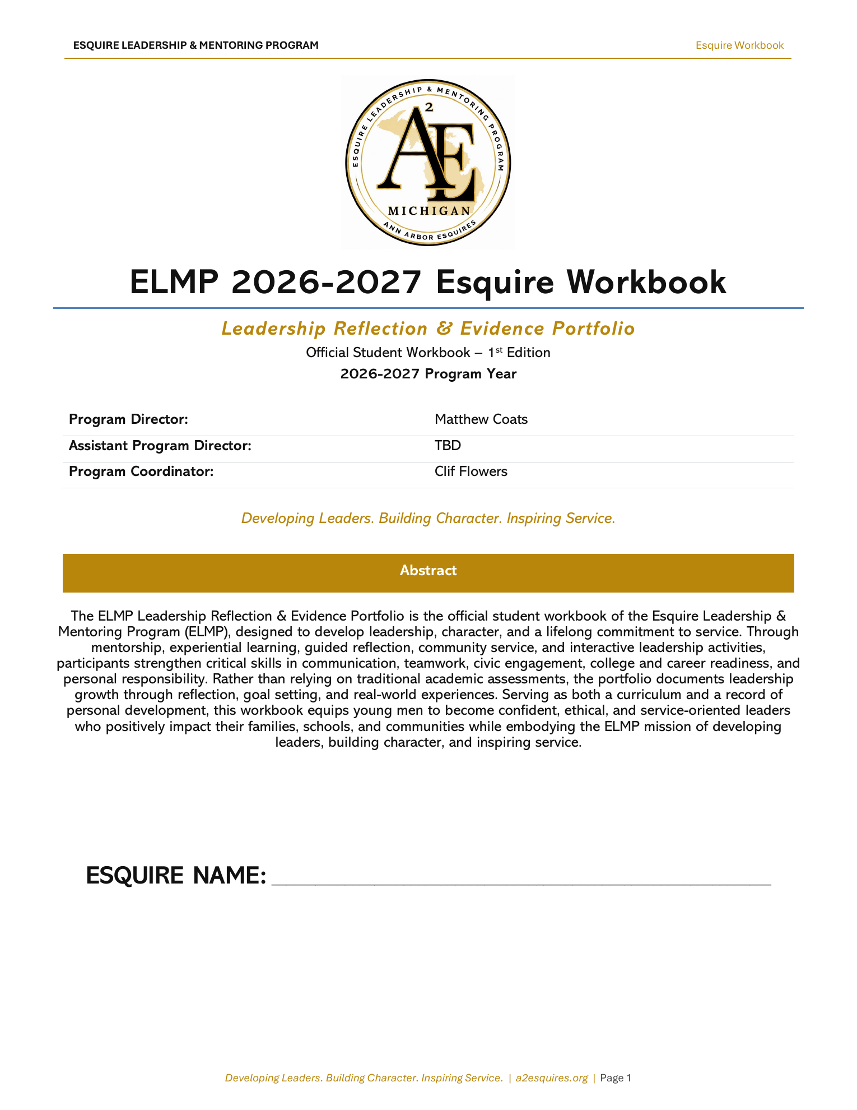
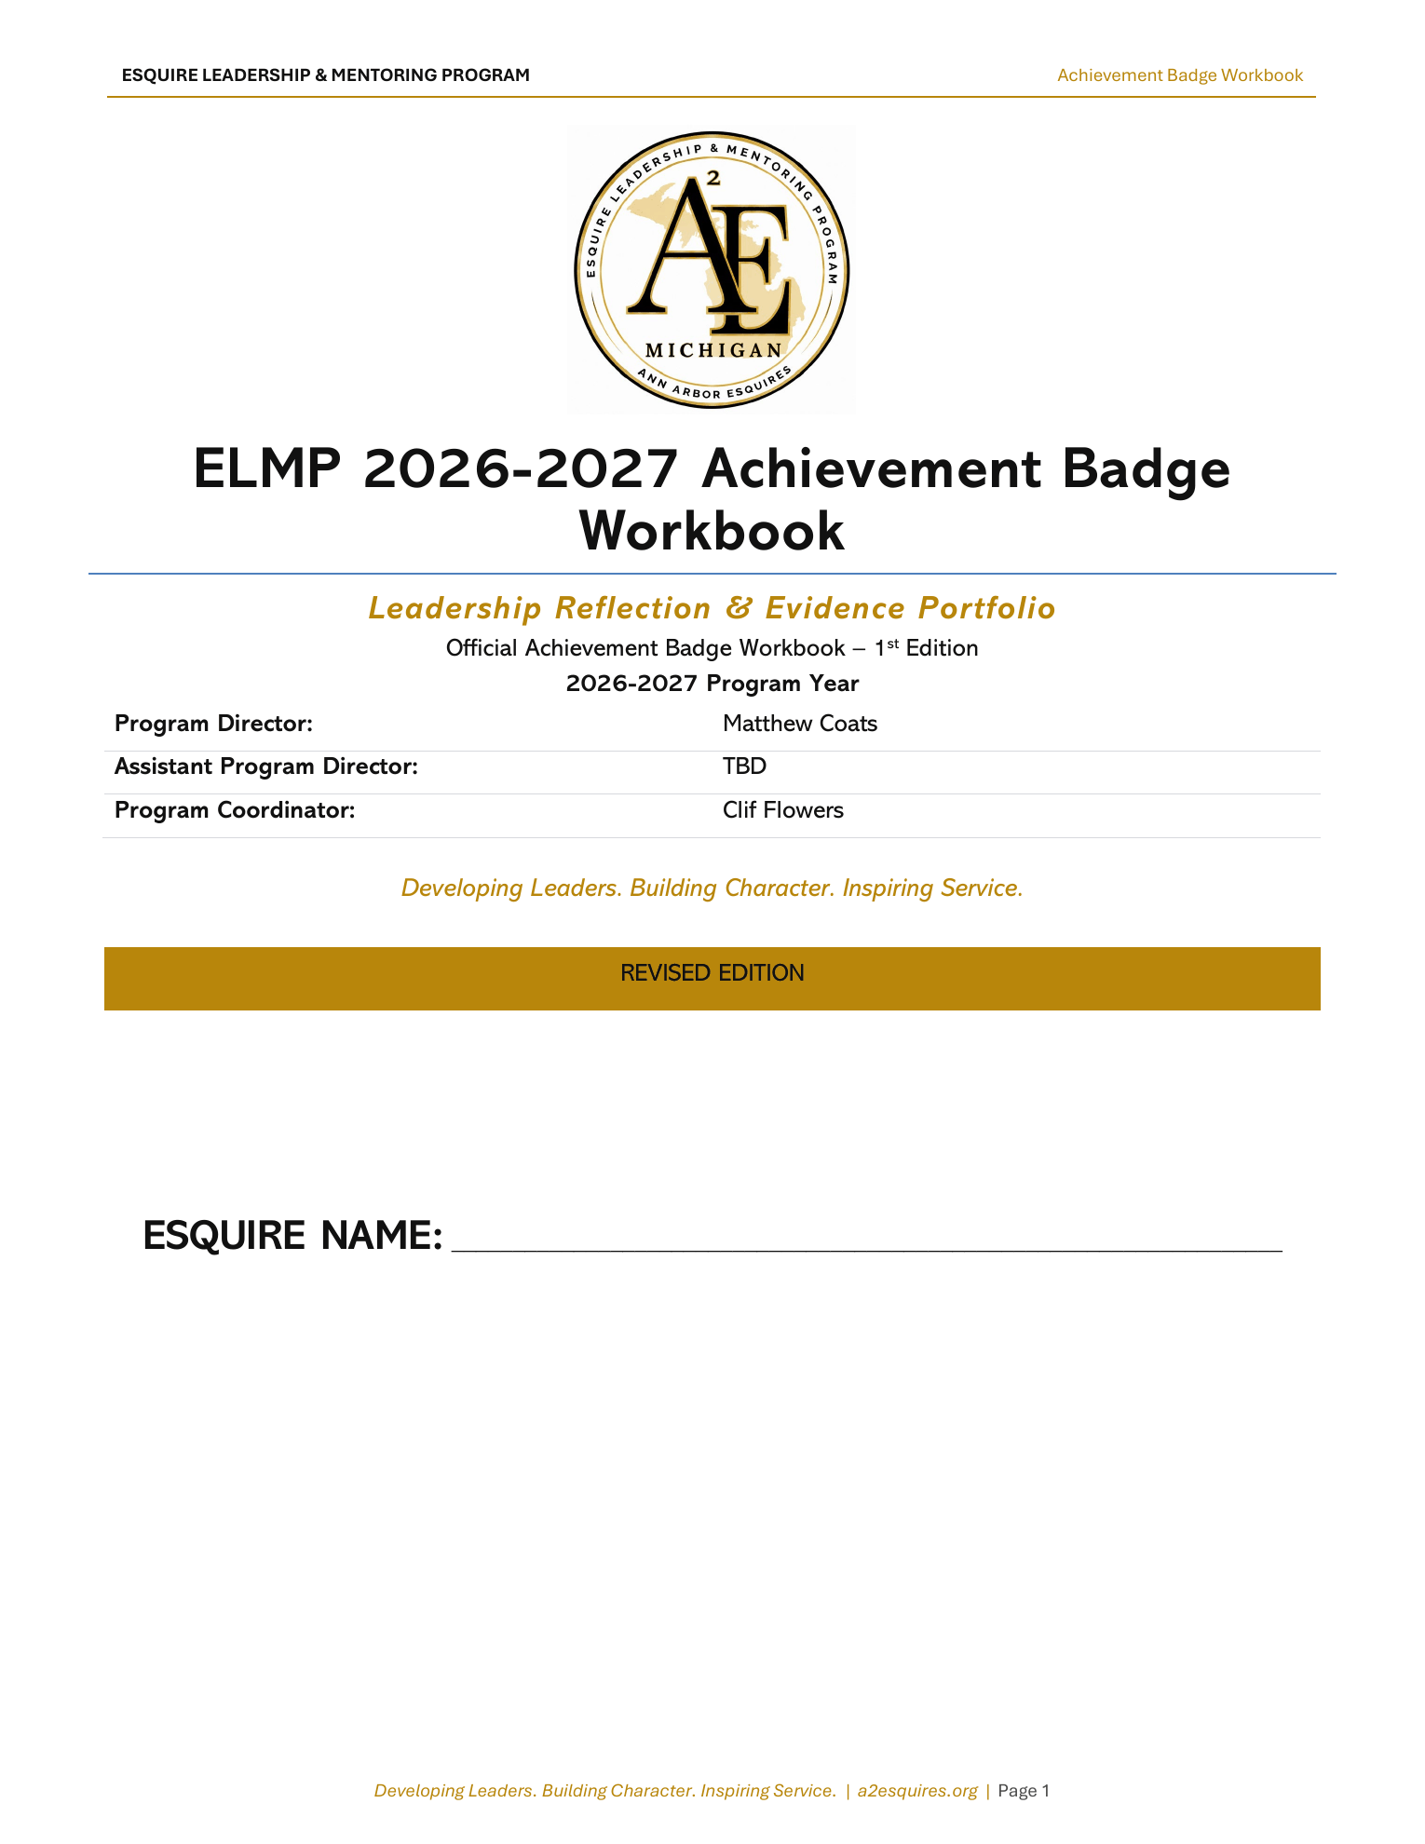
Esquire Workbooks
Reflection, evidence, and recognition tools for the 2026–2027 ELMP year
STANDARD PATHWAY
→
All Esquires build the foundation.
Elite Esquires advance to badge recognition.
→
ELITE RECOGNITION
Esquire Workbook
Achievement Badge Workbook
For all Esquires
For Elite Esquires
Core reflection and evidence portfolio used throughout the ELMP year.
Advanced badge portfolio for Elite Esquires who complete all 20 Success Goals.
Developing Leaders. Building Character. Inspiring Service.

Slide 10

ESQUIRE LEADERSHIP & MENTORING PROGRAM
Saturday Alignment
How Saturdays Align with the Workbooks
The second Saturday teaches the full monthly lesson. The third/fourth Saturday applies the lesson and captures a short reflection.
Click any 120-minute block below to open its detailed explanation.
2nd Saturday: Primary Success Seminar
3rd/4th Saturday: Application Event
FULL 120-MINUTE LEARNING CYCLE
EVENT FIRST • FINAL 15-MINUTE REFLECTION ONLY
10 min
20 min
30 min
25 min
20 min
15 min
Social
Service
Fundraiser
Brotherhood
Opening
History +
Heritage
Featured
Topic
Leadership
Practice
Mentor
Circles
Workbook +
Evidence
Career
Civic
Recognition
Workbook use: Esquire Workbook monthly module, Mentor Circle page, final 15-minute workbook/evidence block, staff tracking, and adult review. Badge evidence may be identified when criteria are met.
15-Minute
Event Reflection
Workbook use: Esquire Workbook event reflection, adult initials, and evidence note. Badge Workbook review happens later only if the activity supports badge criteria.
Guides active on this day: Adult Implementation Guide, History Guide, Structured Group Mentoring Plan, Staff Portfolio, Esquire Workbook, and Badge Workbook as needed.
Key Alignment Rule
Do not add a separate lesson, history block, leadership practice, or Mentor Circle to third- or fourth-Saturday events. The activity is the learning; the final reflection captures the leadership lesson.
Developing Leaders. Building Character. Inspiring Service. | a2esquires.org
Strategic Planning Synopsis

Slide 11
Monthly Leadership Practice Technique
Turning each Success Seminar into a practical leadership lab
Each month, Esquires learn one practical leadership behavior, apply it through a realistic scenario or role-play, discuss it with mentors, reflect in the workbook, and use it in real life.
Belong → Discover → Think Responsibly → Plan → Communicate → Respond Wisely → Engage → Demonstrate Character
Why It Matters
25-Minute Leadership Practice Lab
✓
Each month centers one practical leadership behavior.
✓
1
2
3
4
5
Esquires apply the lesson through a realistic scenario or role-play.
›
Group
Discussion
›
Practice /
Role-Play
›
Mentor
Coaching
›
✓
Scenario
Debrief &
Next Action
Mentors observe, question, coach, and affirm.
✓
Each seminar ends with reflection, evidence, and a 30-day challenge.
Monthly Leadership Topics
MENTOR ROLE
October –
Belonging, Purpose & Standards
November –
Skills, Pathways & Possibilities
December –
Responsible AI, Technology & Leadership
OBSERVE • QUESTION
COACH • AFFIRM
January –
Careers Without Limits
May –
Etiquette, Responsible Choices & Leadership Presence
Esquires do the work.
Mentors guide the thinking.
February –
Professional Development & Communication
March –
Prepared Minds, Calm Responses
April –
Community Voice, Media Literacy & Decisions
★
______________________________
LEADERSHIP • EXCELLENCE • IMPACT
______________________________

Slide 12
Structured Mentoring Circles
Helping Esquires turn leadership practice into reflection, action, and support
Every Esquire participates in a structured 20-minute circle led by a screened adult in an open, observable setting. The circle is not a lecture or an individual mentor match.
CIRCLE STANDARD: Every Esquire may SPEAK, WRITE, or PASS • Facilitators listen more than they lecture • Sensitive concerns go to Program Staff
20-Minute Mentor Circle Flow
2 min
›
5 min
›
6 min
›
4 min
›
3 min
Opening
& Purpose
Round-One
Reflection
Application
Discussion
Action
Commitment
Documentation
& Follow-Up
What the Circle Does
Adult Roles
CORE BOUNDARY
✓
Connects the monthly lesson to real life.
Circle Facilitators
6 leads prompts and records next steps
A circle supports reflection.
It is not a private caseload,
individual match,
or another presentation.
✓
Gives every Esquire a safe way to participate.
Mentor on Duty
supports same-day needs
✓
Names one next action and support need.
Program Staff
documents and follows up
✓
Creates a record for follow-up and evidence.
Peer Leaders
model skills under adult supervision
ACTION + SUPPORT + FOLLOW-UP
LEADERSHIP • EXCELLENCE • IMPACT

Slide 13
PILLAR 1 | BUILD LEADERS
ELMP develops leaders through one connected eight-month journey
Ages 8-17 | October-May | Second-Saturday Success Seminars | Fourth-Saturday Leadership Application
40
8
5
Committed Esquires
Monthly Leadership Themes
Success Goal Areas
HOW THE PROGRAM WORKS
Learn
Support
Apply
Recognize
Success Seminars plus History & Identity sessions
Mentoring, family engagement, and staff follow-up
Service, civic learning, academics, and career readiness
Badges, certificates, jackets, and celebration
Belong
Prepare
Explore
Lead
Oct 2026
Nov-Dec 2026
Jan-Feb 2027
Mar-May 2027
★
ELMP moves Esquires from belonging to leadership through one clear, connected program model.
TZL COMMUNITY & EDUCATION INITIATIVE | 2026-2027

Slide 14
ELMP SAFETY
Training comes first; approval follows screening
Every mentor, facilitator, reviewer, tutor, or Mentor on Duty must complete the full role-approval process before serving.
1
3
100%
MENTOR TRAINING ACADEMY CERTIFICATE
REFERENCES SUBMITTED AND REVIEWED
NSOPW REVIEW + ANNUAL ROLE APPROVAL
BEFORE SERVING
WHILE SERVING
Complete all required training modules
Submit certificate and screening information
Receive confirmation of the approved role from Program Staff
Use open, observable settings and two-adult practices
Use approved communication channels known to families
Protect participant information and document concerns promptly
Training alone does not authorize service. Program Staff confirms approved status after every requirement is reviewed.
TZL COMMUNITY & EDUCATION INITIATIVE | 2026-2027
13
Notes:
Guest presenters and unscreened volunteers do not receive private participant information and do not serve as reviewers. Immediate safety concerns follow the program's reporting and escalation procedure.
[Sources]
- Version 6 ELMP Information Packet(1).pdf (attached)
- https://a2esquires.org/
[/Sources]

Slide 15
STUDENT LEADERSHIP
Leadership Council turns participation into action
An elected Esquire President and Vice President represent student voice, model standards, lead peers, and help plan fourth-Saturday activities.
NOVEMBER
PROGRAM YEAR
ELECT THE LEADERSHIP TEAM
ELECT
LEAD
LEAD, PLAN, AND SERVE
1
2
Candidates speak
Active Esquires vote
Majority decides
Program Staff certifies results
Roll call and openings
Committees and projects
Service, civic, social, and fundraising roles
Recognition Dinner support
Real responsibility remains supervised, age-appropriate, and accountable to Program Staff.
TZL COMMUNITY & EDUCATION INITIATIVE | 2026-2027
14
Notes:
The President and Vice President develop public speaking, facilitation, organization, project management, decision-making, teamwork, and succession skills. Temporary student committees can support approved activities.
[Sources]
- Version 6 ELMP Information Packet(1).pdf (attached)
- https://a2esquires.org/
[/Sources]

Slide 16
ELMP MEASURING SUCCESS
Growth must be visible in verified evidence
The Leadership Reflection and Evidence Portfolio records monthly learning, goals, service, leadership practice, and capstone work.
5
10+
100%
SUCCESS-GOAL CATEGORIES
VERIFIED GOALS EARN THE ESQUIRE JACKET
YEAR-END PROGRESS REVIEW TARGET
FIVE SUCCESS AREAS
EVIDENCE STANDARD
Academic Performance
Attendance and Participation
Leadership and Conduct
College and Career Readiness
Personal Growth and Reflection
Match a specific criterion
Identify date, activity, role, and contribution
Protect private information
Use the Esquire's own reflection
Receive approved adult verification
Attendance alone is not enough unless the criterion specifically measures attendance.
TZL COMMUNITY & EDUCATION INITIATIVE | 2026-2027
16
Notes:
Educational success is holistic: academic progress, life skills, identity, leadership, attendance, service, mentoring reflection, and future planning. Quantitative records and qualitative reviews work together.
[Sources]
- Version 6 ELMP Information Packet(1).pdf (attached)
- https://a2esquires.org/
[/Sources]

Slide 17
SUCCESS GOAL PROCESS
A Success Goal becomes credit only after verification
The same four-step cycle applies across all five goal categories and every recognition level.
STEP 1 | SELECT
STEP 2 | ACT
STEP 3 | DOCUMENT
STEP 4 | VERIFY
Choose a criterion
Complete the work
Reflect + submit
Approve + recognize
• Review one official indicator
• Set a clear next action
• Confirm acceptable evidence
• Participate meaningfully
• Take an approved role
• Record date and contribution
• Add evidence to the portfolio
• Explain learning in his own words
• Protect private information
• Approved adult checks the standard
• Program Staff records credit
• Badge or tier progress updates
5
20
10
→
SUCCESS-GOAL CATEGORIES
OFFICIAL SUCCESS CRITERIA
VERIFIED GOALS EARN THE JACKET
PROGRESS CARRIES FORWARD WHILE ACTIVE
Evidence must match the criterion. Attendance alone counts only when attendance is the indicator.
TZL COMMUNITY & EDUCATION INITIATIVE | 2026-2027
17
Notes:
Walk the Brothers through the handoff: an Esquire selects a criterion, completes the work, documents and reflects, and receives credit only after an approved adult verifies the standard. Staff then records progress toward category badges, tier badges, and the jacket.
[Sources]
- Version 6 ELMP Information Packet(1).pdf (attached), pages 19-21
- https://a2esquires.org/
[/Sources]

Slide 18
ELMP RECOGNITION
Visible milestones reward persistence and verified growth
Progress is cumulative while the Esquire remains active; approved adults verify credit before recognition is awarded.
1-5
6-9
10+
20/20
Success Goals
Graduate
BRONZE |
RISING LEADER
SILVER |
DEDICATED SCHOLAR
GOLD |
ELITE ESQUIRE + JACKET
DISTINGUISHED ESQUIRE | 12 ACHIEVEMENT BADGES
LEGACY ESQUIRE | HIGHEST HONOR
Upper-tier system
Elite: 10+ goals and consistent participation
Distinguished: complete all 20 goals, multiple years, sustained leadership, 12 Achievement Badges
Legacy: program completion, graduation, exemplary service
Annual lapel pins, category badges, certificates, and recognition dinner
The jacket tells a growth story
Recognition celebrates documented preparation, character, leadership, service, and long-term commitment.
TZL COMMUNITY & EDUCATION INITIATIVE | 2026-2027
18
Notes:
Returning Esquires retain earned badges, awards, and years of participation as they progress toward Distinguished and Legacy recognition.
[Sources]
- Version 6 ELMP Information Packet(1).pdf (attached)
- https://a2esquires.org/
[/Sources]

Slide 19
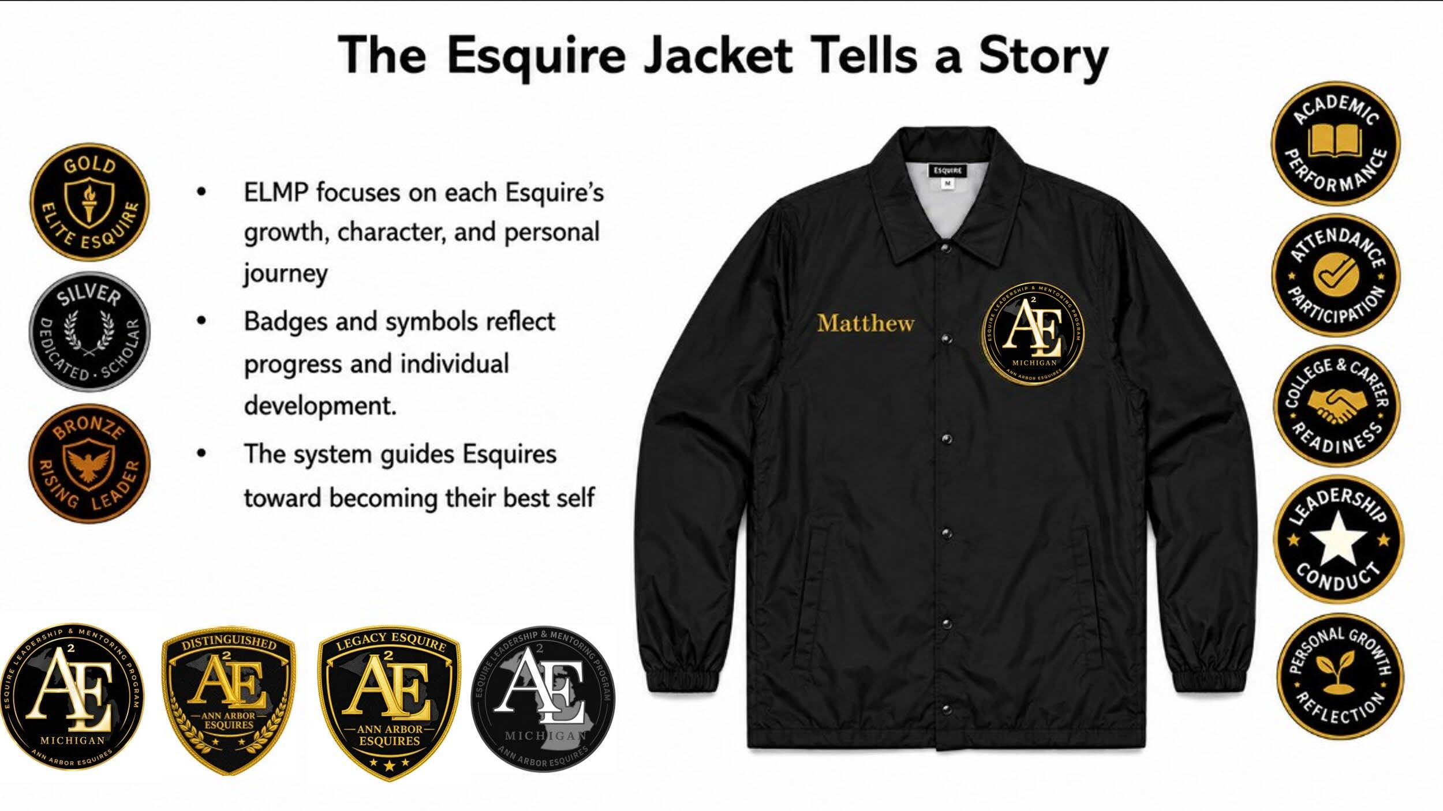
ELMP ORIGINAL REWARD SYSTEM
The original badges make verified growth visible
Bronze, Silver, Gold, five Success Goal category badges, and upper-tier insignia tell the jacket's story.
ORIGINAL SYSTEM: 3 TIER BADGES | 5 SUCCESS-GOAL BADGES | UPPER-TIER INSIGNIA | JACKET
TZL COMMUNITY & EDUCATION INITIATIVE | 2026-2027
19
Notes:
Use the visual to distinguish the original recognition system from the twelve supplemental achievement badges. Bronze marks 1-5 goals, Silver marks 6-9, Gold/Elite and the jacket begin at 10+, and the five category badges show where growth occurred.
[Sources]
- Version 6 ELMP Information Packet(1).pdf (attached), page 25
[/Sources]

Slide 20



UPPER-TIER RECOGNITION
Awards mark sustained commitment across the years
Returning Esquires keep prior awards; annual lapel pins record each year of participation.
ELITE ESQUIRE
DISTINGUISHED ESQUIRE
LEGACY ESQUIRE
10+ verified goals, reliable participation, mentoring reflection, positive conduct, and steady growth.
All 20 goals, multiple years, sustained leadership, positive peer influence, service, and an annual lapel pin.
Graduation, long-term commitment, exemplary leadership and service, lasting impact, and an annual lapel pin.
EARN > RETURN > LEAD > GRADUATE | LAPEL PINS MARK EACH YEAR
TZL COMMUNITY & EDUCATION INITIATIVE | 2026-2027
20
Notes:
Elite recognizes active Esquires who meet 10 or more goals. Distinguished recognizes returning Esquires who achieve all 20 goals and demonstrate sustained leadership. Legacy is the highest honor for graduating Esquires with exemplary long-term service. Distinguished and Legacy visuals include the annual lapel pin.
[Sources]
- Version 6 ELMP Information Packet(1).pdf (attached), pages 21-22
[/Sources]

Slide 21
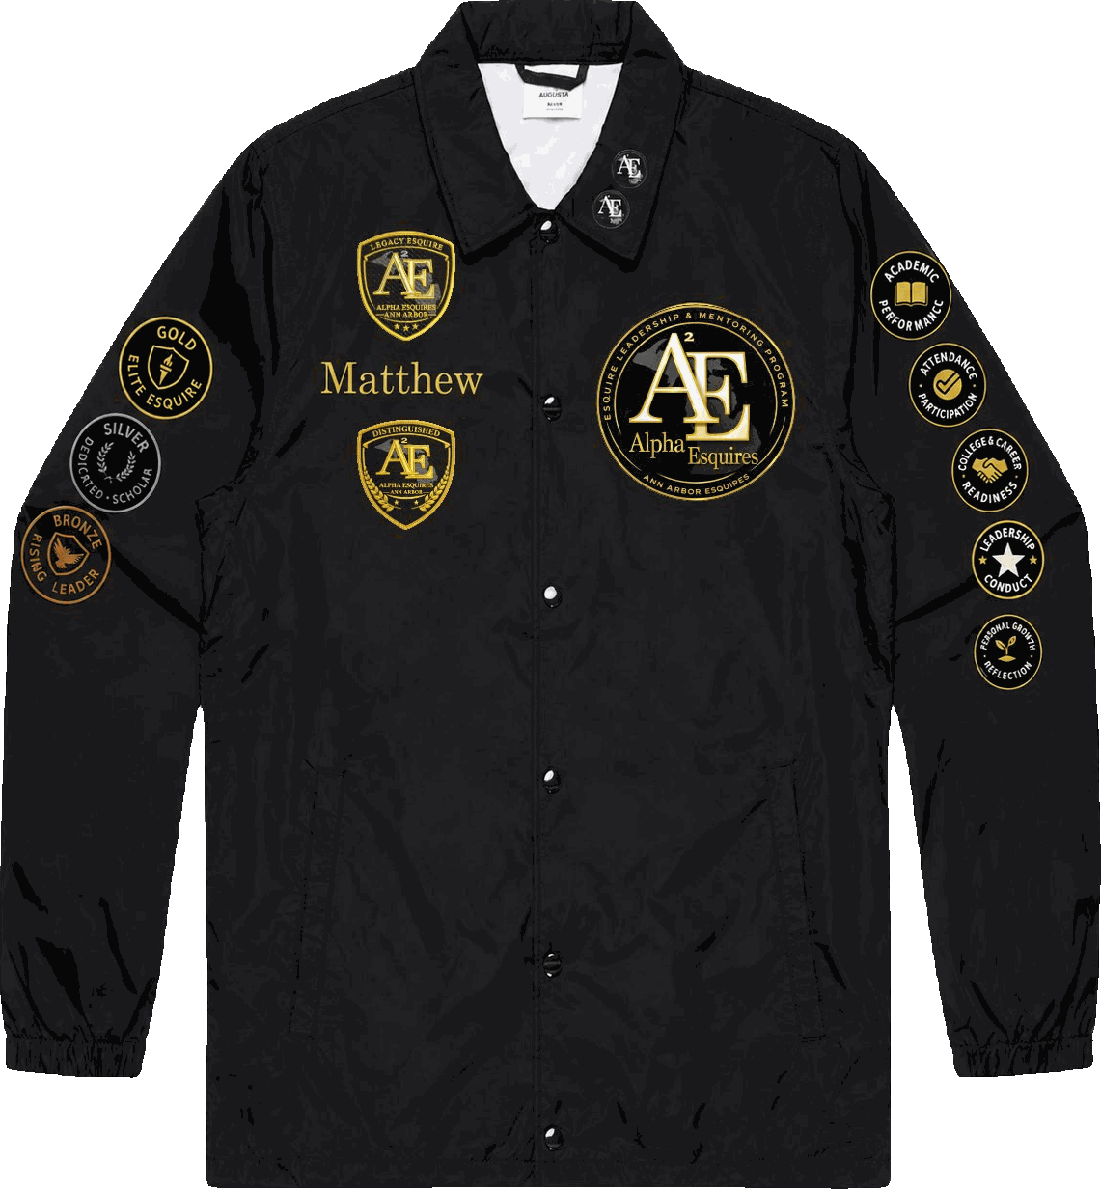
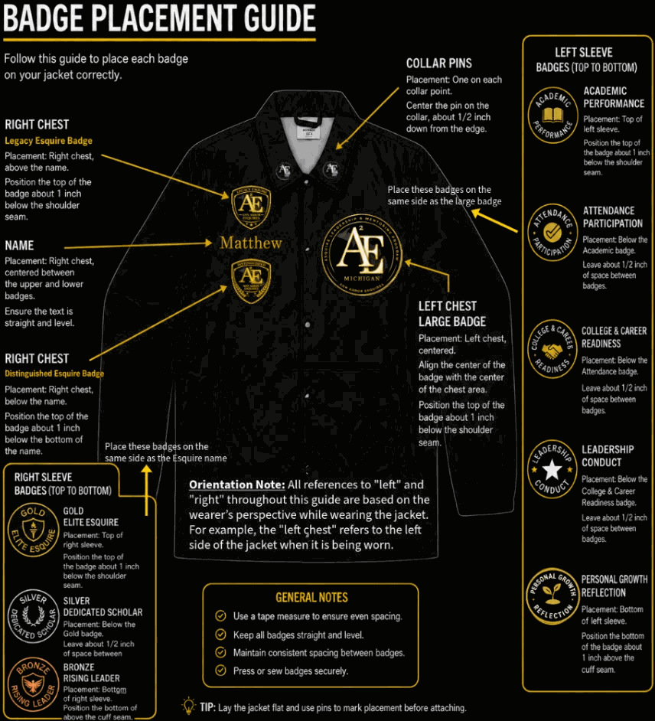
ELMP JACKET & INSIGNIA
The jacket carries an Esquire's documented journey
Official placement keeps recognition consistent while the badges show growth, character, leadership, and service.
ESQUIRE JACKET
BADGE PLACEMENT GUIDE
LEFT COLLAR: ANNUAL PINS | CHEST: NAME + CORE INSIGNIA | SLEEVES: TIER, CATEGORY, AND ACHIEVEMENT BADGES
TZL COMMUNITY & EDUCATION INITIATIVE | 2026-2027
21
Notes:
Point out the annual collar pin, name placement, large chest badge, tier badges on the right sleeve, and category/achievement badges on the left sleeve. Orientation references left and right from the jacket wearer's perspective.
[Sources]
- Version 6 ELMP Information Packet(1).pdf (attached), pages 23-24
[/Sources]

Slide 22



SUPPLEMENTAL BADGES | 1-3
Badges 1-3: service, heritage, and civic voice
Each pathway requires participation, responsibility, evidence, reflection, and adult verification.
01 | SERVICE LEADER
02 | HISTORY & HERITAGE
03 | CIVIC AMBASSADOR
3 approved service activities • 10 documented hours • assigned leadership role • reflection.
6 history sessions • approved research • a written, visual, digital, or creative project • presentation.
Approved civic event • issue research • active event role • reflection on informed citizenship.
SERVICE | IDENTITY | INFORMED CITIZENSHIP
TZL COMMUNITY & EDUCATION INITIATIVE | 2026-2027
22
Notes:
Official names are Community Service Leader Badge; History, Heritage, and Cultural Identity Scholar Badge; and Civic Engagement Ambassador Badge. The visible criteria summarize the packet; staff use the Achievement Badge Workbook for verification.
[Sources]
- Version 6 ELMP Information Packet(1).pdf (attached), page 26
[/Sources]

Slide 23



SUPPLEMENTAL BADGES | 4-6
Badges 4-6: presence, communication, and pathways
These badges turn professional conduct, public speaking, and future exploration into evidence.
04 | PROFESSIONAL PRESENCE
05 | PUBLIC SPEAKING
06 | COLLEGE & CAREER
Etiquette session • professional introductions and conduct • approved activity • consistent Code of Conduct.
Communication activity • prepared two-minute presentation • thoughtful question • feedback applied.
2 exposure activities • professional interview • Life Plan update • resume, portfolio, or career reflection.
PRESENT | COMMUNICATE | EXPLORE
TZL COMMUNITY & EDUCATION INITIATIVE | 2026-2027
23
Notes:
Official names are Professional Presence and Etiquette Badge; Public Speaking and Communication Badge; and College and Career Explorer Badge.
[Sources]
- Version 6 ELMP Information Packet(1).pdf (attached), page 27
[/Sources]

Slide 24



SUPPLEMENTAL BADGES | 7-9
Badges 7-9: technology, peers, and projects
Esquires must show safe judgment, positive peer influence, and accountable project completion.
07 | RESPONSIBLE AI
08 | PEER LEADERSHIP
09 | PROJECT LEADERSHIP
Approved tech session • practical tool use • privacy, bias, accuracy, and authorship explained • project.
Support peers 3 times • lead an activity • model positive influence • adult recommendation.
Plan purpose, tasks, timeline, and roles • help complete the project • present results and reflection.
USE WISELY | LIFT OTHERS | FINISH THE WORK
TZL COMMUNITY & EDUCATION INITIATIVE | 2026-2027
24
Notes:
Official names are Technology and Responsible AI Badge; Peer Leadership and Brotherhood Badge; and Project Leadership Badge.
[Sources]
- Version 6 ELMP Information Packet(1).pdf (attached), page 28
[/Sources]

Slide 25



SUPPLEMENTAL BADGES | 10-12
Badges 10-12: resilience, attendance, and outreach
The final pathways reward sustained improvement, dependable participation, and responsible representation.
10 | ACADEMIC RESILIENCE
11 | ATTENDANCE EXCELLENCE
12 | COMMUNITY OUTREACH
Name a challenge • follow a support plan for 4 weeks or a grading period • document progress and reflection.
90% school • 85% eligible ELMP activities • 90% on time and prepared • required records complete.
Approved fundraising or outreach role • professional representation • reflection • verified completion.
PERSEVERE | SHOW UP | REPRESENT WELL
TZL COMMUNITY & EDUCATION INITIATIVE | 2026-2027
25
Notes:
Official names are Academic Resilience Badge; Attendance Excellence Badge; and Fundraising and Community Outreach Badge. Badge methods may be adjusted for age, reading level, disability, or documented need while preserving the standard.
[Sources]
- Version 6 ELMP Information Packet(1).pdf (attached), page 29
[/Sources]

Slide 26
ELMP 2026-2027 OUTCOMES
The plan measures evidence, action, and support
Targets describe what Esquires will complete and how Program Staff will verify development during the year.
75%
60%
100%
COMPLETE A LIFE PLAN + 4 VERIFIED EVIDENCE ENTRIES
EARN AT LEAST ONE APPROVED ACHIEVEMENT BADGE
RECEIVE A YEAR-END PROGRESS REVIEW
APPLIED LEADERSHIP
APRIL CIVIC EVIDENCE
75% complete one Caring & Sharing service experience and one Empower civic experience
80% complete at least one college or career exposure activity
25 Esquires attend the fourth-Saturday Youth Town Hall
20 complete a community decision brief or documented civic action
Academic support: acknowledge every approved tutoring request within 5 business days and document the referral and outcome.
TZL COMMUNITY & EDUCATION INITIATIVE | 2026-2027
26
Notes:
These targets work alongside the operating goals of 40 enrolled, 36 active through May, average primary-seminar attendance of 25, and a 90% retention target.
[Sources]
- TZL CEI Strategic Plan 2026-2027 Presentation Community Benefit Scorecard.pptx (attached)
- Version 6 ELMP Information Packet(1).pdf (attached)
[/Sources]

Slide 27

PILLAR 2 | STRENGTHEN FAMILIES
Dr. Thomas A. Bass Caring & Sharing Food Basket Delivery Program turns compassion into organized care
Since 1987, the men of Theta Zeta Lambda Chapter have supported families across Washtenaw and Western Wayne County through the Brother Dr. Thomas A. Bass Caring & Sharing Program.
1987
3
7
12
SEASONAL FOOD DISTRIBUTIONS
Thanksgiving • Christmas • Easter
Food baskets & gift cards
CORE PROGRAM COMPONENTS
MONTHS OF CARE AND FOLLOW-THROUGH
PROGRAM ESTABLISHED
James D. Moore proposed assisting area families.
Service legacy and mission
Caring & Sharing reflects the Fraternity motto, “Manly Deeds, Scholarship, and Love for All Mankind,” through organized service and year-round care.
Strengthen families, honor elders, uplift children, and build resilient communities.
Treat every family with dignity, privacy, and compassion.
Manage resources, volunteer time, and partnerships responsibly.
Document needs, services, outcomes, and follow-through accurately.
PROGRAM STAFF
Co-Program Director: Jermel Ray
Co-Program Director: Matthew Coats
Lead Advisor: Marion Hoey
BROTHER'S KEEPER
Delivered locally through Senior Connection for senior, retired, ill, homebound, or otherwise vulnerable Brothers and widows of deceased Brothers, with needs identified and followed through.
TZL COMMUNITY & EDUCATION INITIATIVE | 2026-2027
27
Notes:
The program honors charter member Dr. Thomas A. Bass and serves Washtenaw County and surrounding communities. What began as holiday food baskets now includes essentials, seniors, winter support, sponsorship, volunteer service, and safety education.
[Sources]
- Caring_and_Sharing_2026-2027_Information_Packet.pdf (attached)
- https://tzlcaringsharing.org/
[/Sources]

Slide 28
CARING & SHARING SERVICE MODEL
A full circle connects need, service, and follow-through
Families and partners experience one coordinated model built around respectful outreach, clear roles, accurate records, and continued connection.
01
IDENTIFY THE NEED
02
PREPARE WITH CARE
03
SERVE WITH DIGNITY
Referrals, schools, churches, partners, and outreach identify households and elders needing support.
Volunteers collect, purchase, organize, and pack food, hygiene items, clothing, toys, and supplies.
Deliver respectfully while protecting privacy, safety, family needs, and hope.
04
CONNECT PEOPLE
05
BUILD PARTNERSHIPS
06
FOLLOW THROUGH
Senior Connection / Brother's Keeper contacts, widow visits, youth service, and needs follow-through build relationships.
Schools, businesses, donors, sponsors, nonprofits, churches, and volunteers expand capacity.
Year-round referrals, impact tracking, continued contact, and review turn projects into sustained care.
IDENTIFY > PREPARE > SERVE > CONNECT > PARTNER > FOLLOW THROUGH
Standard for every experience: organized preparation, respectful delivery, clear roles, accurate records, privacy, and meaningful follow-through.
TZL COMMUNITY & EDUCATION INITIATIVE | 2026-2027
28
Notes:
The model is deliberately relational. Caring & Sharing provides items, but also builds reliable connections, intergenerational care, and evidence that families and elders are not alone.
[Sources]
- Caring_and_Sharing_2026-2027_Information_Packet.pdf (attached)
- https://tzlcaringsharing.org/
[/Sources]

Slide 29
CARE COMPONENTS
Seven connected initiatives provide practical care throughout the year
The food-basket tradition remains central while other components address daily needs, isolation, winter hardship, stability, and safety.
01
FOOD BASKET DELIVERY
02
FAMILY ESSENTIALS DRIVE
03
SENIOR CONNECTION | BROTHER'S KEEPER
Easter, Thanksgiving, and Christmas baskets, with gift cards or equivalent support when appropriate.
Hygiene, household care, baby items, and school-readiness supplies distributed through trusted partners.
Two meaningful contacts each year for every Brother on the approved roster: widow visits, wellness calls, technology help, needs identification, referrals, and follow-up.
04
WINTER ATTIRE & TOYS
05
FAMILY SPONSORSHIP
06
CPR & AED TRAINING
Coats, hats, scarves, gloves, boots, and new unwrapped toys are organized for safe distribution.
Approved partners connect sponsors with protected wish lists, food, gifts, winter items, and essentials.
Qualified instructors provide certified or approved lifesaving education for youth and adults.
07
YCMS FOOD PANTRY EXPANSION
Partnership with Food Gatherers to expand the YCMS Food Pantry and serve senior community members.
FOOD > ESSENTIALS > CONNECTION > WINTER > SPONSORSHIP > SAFETY
Quality standard: never represent training as certified unless the instructor, curriculum, assessment, and certificate meet the issuing organization's requirements.
TZL COMMUNITY & EDUCATION INITIATIVE | 2026-2027
29
Notes:
Senior volunteers do not provide medical, legal, financial, or professional advice unless qualified and approved. Family hardship is never used as a public display; privacy and dignity take priority over recognition.
[Sources]
- Caring_and_Sharing_2026-2027_Information_Packet.pdf (attached)
- https://tzlcaringsharing.org/
[/Sources]

Slide 30
CARING & SHARING ANNUAL RHYTHM
Two Senior Connection outreach windows strengthen year-round service
Fall and spring contacts are supported by seasonal care, roster maintenance, referrals, and follow-through.
SEP-DEC
JAN-APR
MAY-AUG
YEAR ROUND
Fall + Early Winter
Winter + Early Spring
Spring + Summer
Continuous Care
• Family Essentials Drive
• Senior Connection fall contact window
• Thanksgiving and Christmas baskets
• Senior Connection spring contact window
• Easter food-basket delivery
• Follow-up on identified needs
• Refresh chapter contact / phone list
• Back-to-school planning
• Volunteer and partner development
• Family referrals and needs response
• Widow connection as needed
• Grants, sponsorships, impact tracking
3
7
2
1
SEASONAL
DISTRIBUTION ANCHORS
CORE PROGRAM
COMPONENTS
ANNUAL SENIOR CONNECTION
CONTACT WINDOWS
ANNUAL
IMPACT REPORT
Measure families, Brothers, widows, contacts, identified needs, resolved needs, items, volunteers, service hours, partners, stewardship, quality, and unresolved needs.
TZL COMMUNITY & EDUCATION INITIATIVE | 2026-2027
30
Notes:
Exact activity dates can move. The operating rhythm should remain stable: seasonal distribution, continuous referral review, senior connection, resource development, and documentation.
[Sources]
- Caring_and_Sharing_2026-2027_Information_Packet.pdf (attached)
- https://tzlcaringsharing.org/
[/Sources]

Slide 31
SENIOR CONNECTION | A. CHARLES HASTON BROTHER'S KEEPER
Twice-yearly contact turns Brotherhood into organized care
Senior Connection is Caring & Sharing's local delivery of Brother's Keeper. Widow outreach remains inside this same component rather than becoming a separate program.
COVERAGE STANDARD
CONTACT + CARE
OPERATING MECHANISMS
2X
3
Updated chapter phone/contact list
Preferred communication method
Assigned Brothers or outreach leads
Contact dates and brief status
Need identified + response owner
Follow-up / referral through closure
Known widows included in the same system
MEANINGFUL CONTACTS
PER PROGRAM YEAR
PRIMARY OPTIONS
PHONE • IN PERSON • ZOOM/VIDEO
1
100%
NEEDS PATHWAY THROUGH
CARING & SHARING
APPROVED SENIOR CONNECTION
ROSTER COVERAGE
Ask: How are you doing? Is anything needed? What is the best way for us to stay connected?
CONTACT > LISTEN > IDENTIFY NEED > RESPOND > FOLLOW UP > DOCUMENT
ROSTER FOCUS: senior, retired, ill, homebound, or otherwise vulnerable Brothers + known widows
TZL COMMUNITY & EDUCATION INITIATIVE | 2026-2027
7
Notes:
[Sources]
- TZL CEI Strategic Plan 2026-2027.docx, Caring & Sharing Goals
- Caring and Sharing Accomplishments 2025 - 2026(1).docx
- Caring_and_Sharing_2026-2027_Information_Packet.pdf
[/Sources]

Slide 32
CARING OPERATIONS
Every referral or Senior Connection needs to move through review and follow-through
A consistent process protects family and Brother privacy, makes volunteer roles clear, and records what support was actually delivered.
REFERRAL & REVIEW
SERVICE DELIVERY
FOLLOW-THROUGH
7
100%
Leadership clarifies the need and available capacity
Approved support is prepared and delivered respectfully
Completed deliveries, expenses, and outcomes are recorded
Unresolved needs receive resource connection when possible
Quality review improves the next service cycle
BUSINESS-DAY REVIEW TARGET
ASSIGNMENTS CONFIRMED BEFORE SERVICE
100%
1
PRIVACY, SAFETY, AND SUPERVISION EXPECTED
OFFICIAL RECORD FOR EACH APPROVED CASE
Volunteers follow the assigned lead and report concerns promptly.
Senior Connection data is limited to approved leadership and assigned Brothers who need it for an approved follow-up.
TZL COMMUNITY & EDUCATION INITIATIVE | 2026-2027
32
Notes:
Family names, addresses, phone numbers, and circumstances are shared only with people who need the information for an approved assignment. No volunteer posts private stories or photos without written approval.
[Sources]
- Caring_and_Sharing_2026-2027_Information_Packet.pdf (attached)
- https://tzlcaringsharing.org/
[/Sources]

Slide 33

PILLAR 3 | EMPOWER COMMUNITIES
Empower builds trust through three civic anchors
TZL Empower is the local civic-engagement delivery of Alpha's A Voteless People is a Hopeless People (VPHP), anchored by the September Symposium and April Community Voice + Media Literacy Success Seminar & Youth Town Hall.
A VOTELESS PEOPLE IS A HOPELESS PEOPLE
2023
TZL Empower is Theta Zeta Lambda Chapter's local expression of Alpha Phi Alpha's "A Voteless People is a Hopeless People" (VPHP) national program. It advances VPHP through nonpartisan voter education, civic awareness, community forums, and engagement that encourages informed participation and empowers residents to use their voices to strengthen their communities.
PROGRAM STAFF
TZL Empower was established in 2023 by Dr. Travis Martin, Leland Walker, and Don Adams. The idea was to create a Theta Zeta Lambda Chapter initiative connected directly to the National Program: A Voteless People Is A Hopeless People.
Program Director: Don Adams
Assistant Program Director: Matthew Coats
15 trained volunteers | 3 civic partners | 100% nonpartisan review | 14-day after-action reports
TZL COMMUNITY & EDUCATION INITIATIVE | 2026-2027
33
Notes:
TZL Empower is the chapter's official civic engagement initiative. Its mission is to educate residents, strengthen voter engagement, promote informed decisions, and encourage responsible democratic participation without endorsing parties or candidates.
[Sources]
- TZL_Empower_2026-2027_Information_Packet(1).pdf (attached)
- TZL CEI Strategic Plan 2026-2027 Presentation Community Benefit Scorecard.pptx (attached)
- https://tzlempower.org/
[/Sources]

Slide 34
TZL EMPOWER | 2026 CIVIC EDUCATION SYMPOSIUM
Civic information becomes participation
A free, nonpartisan forum connects residents with public leaders, trustworthy information, respectful dialogue, and opportunities to engage.
Theme: Understanding the Issues. Understanding the Ballot. Understanding Your Voice.
Purpose: Provide non-partisan civic education rather than endorse candidates or political parties.
Help residents understand:
  How local and state government affect everyday life
  Major community issues
  Offices appearing on the ballot
  How elected officials make decisions
  Ways residents can become more civically involved
Major discussion areas:
  State of Ann Arbor and Ypsilanti communities
  Housing, affordability, homeownership, and economic equity
  Public safety, mental health, youth violence prevention, and community wellness
  Education, career and technical education, workforce readiness, and college affordability
  State legislative issues and funding
  Understanding elected offices, ballot proposals, and millages
SEP 10
THURSDAY | 6:00-8:00 PM
WCC ROOM 140
Liberal Arts Building, College Theater
4800 E. Huron River Drive, Ann Arbor
FREE | NONPARTISAN | ACCURATE INFORMATION | RESPECTFUL QUESTIONS | DOCUMENTED RESULTS
TZL COMMUNITY & EDUCATION INITIATIVE | 2026-2027
37
Notes:
The Symposium should help residents understand how public decisions affect everyday life. Final public materials require verification of dates, offices, resources, logos, links, nonpartisan language, and accessibility.
[Sources]
- TZL_Empower_2026-2027_Information_Packet(1).pdf (attached)
- https://tzlempower.org/
[/Sources]

Slide 35
ELMP + TZL EMPOWER
April turns civic learning into youth leadership
A preparation seminar builds the information, communication, media-literacy, and decision-making skills Esquires will use at the Youth Town Hall.
APRIL 10
APRIL 24
PREPARATION SEMINAR
LEARN
APPLY
YOUTH TOWN HALL
1
2
25+ Esquires
Community voice and media literacy
Respectful questions and decision-making
Community decision-brief preparation
100+ total attendees
25+ Esquires present
10+ Esquires in active roles
20 decision briefs or civic actions
Verified evidence connects the two experiences.
TZL COMMUNITY & EDUCATION INITIATIVE | 2026-2027
38
Notes:
Esquire roles can include ambassador, greeter, registration assistant, outreach volunteer, student question presenter, issue researcher, or reflection author. Participation remains educational, supervised, and nonpartisan.
[Sources]
- TZL CEI Strategic Plan 2026-2027 Presentation Community Benefit Scorecard.pptx (attached)
- Version 6 ELMP Information Packet(1).pdf (attached)
- TZL_Empower_2026-2027_Information_Packet(1).pdf (attached)
[/Sources]

Slide 36
TZL EMPOWER CIVIC ENGAGEMENT CYCLE
Community voice becomes power through preparation
Empower moves residents and volunteers from awareness to sustained community leadership through one connected, nonpartisan model.
01
LEARN THE COMMUNITY
02
EDUCATE RESIDENTS
03
BUILD RELATIONSHIPS
Review needs, population trends, public issues, precinct data, relationships, and barriers.
Share clear information about registration, voting options, public offices, ballot questions, and decisions.
Work with schools, faith groups, neighborhoods, nonprofits, businesses, and institutions.
04
REACH RESIDENTS
05
MOBILIZE PARTICIPATION
06
MEASURE & IMPROVE
Use registration drives, outreach, digital education, forums, and public events.
Promote early voting, share reminders, reduce barriers, and encourage informed action.
Evaluate turnout, registrations, households reached, partnerships, volunteers, and precinct progress.
LEARN > EDUCATE > RELATE > REACH > MOBILIZE > IMPROVE
Community outcome: informed, engaged, and active residents who help build stronger, safer, and more responsive communities.
TZL COMMUNITY & EDUCATION INITIATIVE | 2026-2027
34
Notes:
The nonpartisan standard requires factual, balanced, respectful, and accessible materials; no party or candidate endorsement; and no pressure on residents to support a particular choice.
[Sources]
- TZL_Empower_2026-2027_Information_Packet(1).pdf (attached)
- https://tzlempower.org/
[/Sources]

Slide 37
TZL EMPOWER OPERATING STRUCTURE
Local teams follow one regional civic strategy
Seven operational areas, committee leadership, area teams, and focus councils connect data, relationships, outreach, and volunteer action.
SERVICE AREA FRAMEWORK
LEADERSHIP STRUCTURE
COMMUNITY CONNECTION
7
7
Areas: Ann Arbor; Ypsilanti; Southern and Western Washtenaw; Western Wayne Central and South; Canton
Area teams: lead, data, outreach, volunteer, liaison
Focus councils: new voter, faith/community, senior, family/neighborhood, civic education
Youth connection: ELMP ambassadors, research, speaking, and supervised service
OPERATIONAL SERVICE AREAS
COMMITTEE LEADERSHIP ROLES
5
70%
STANDARD AREA-TEAM ROLES
MINIMUM TURNOUT BENCHMARK
Chair, Vice Chair, data, outreach, youth/new voter, communications, and volunteers
Local relationships drive regional impact; public information remains accurate, current, plain-language, and nonpartisan.
TZL COMMUNITY & EDUCATION INITIATIVE | 2026-2027
35
Notes:
Each area uses local knowledge and trusted partners while following one shared Empower strategy. The seven areas span Washtenaw County and selected Western Wayne County communities.
[Sources]
- TZL_Empower_2026-2027_Information_Packet(1).pdf (attached)
- https://tzlempower.org/
[/Sources]

Slide 38
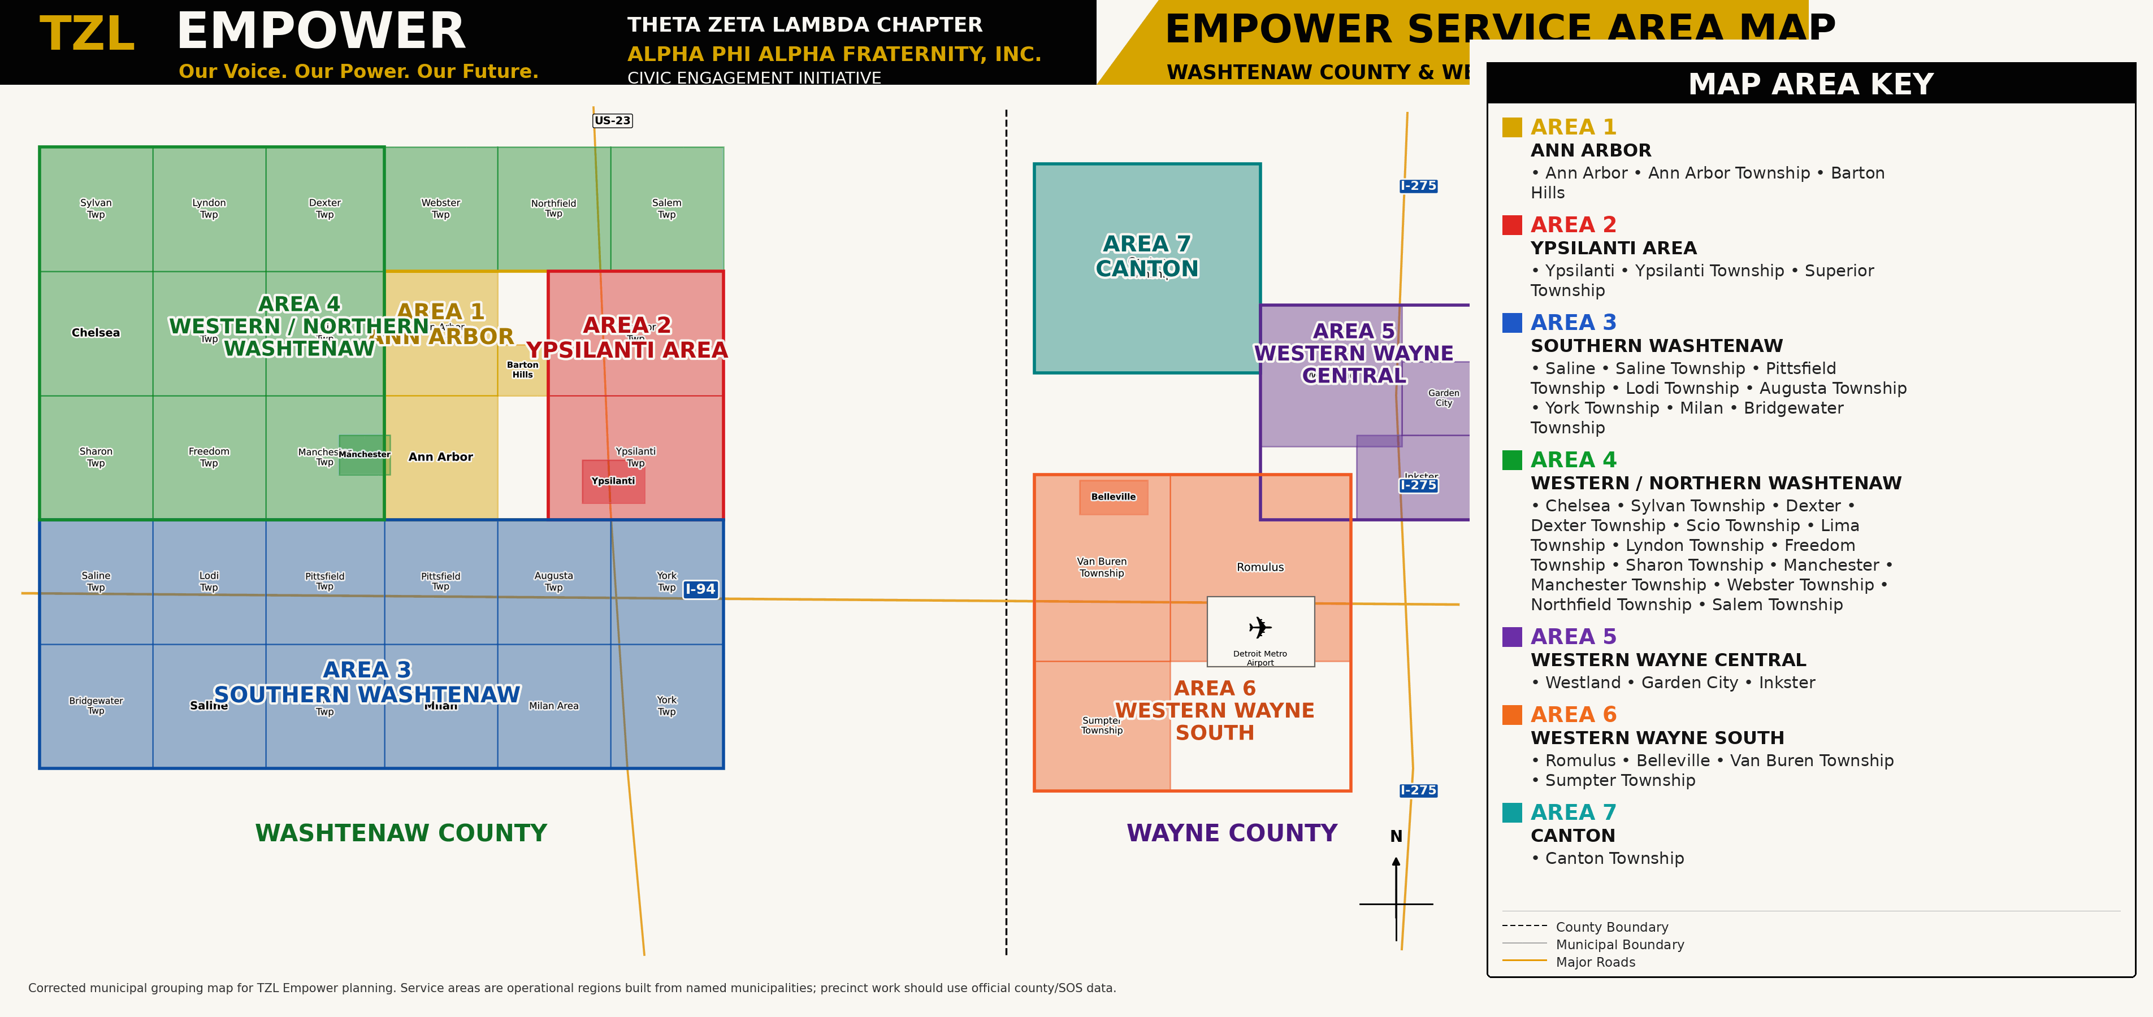

Slide 39
ELECTION RHYTHM
Data guides service; trusted relationships create change
Year-round civic education continues between elections, while focused activity intensifies as official election dates approach.
90 DAYS BEFORE
60 DAYS BEFORE
30 DAYS-ELECTION
AFTER ELECTION
Analyze + Plan
Register + Educate
Reach + Mobilize
Evaluate + Improve
• Review turnout and precinct data
• Identify priority areas
• Confirm partners and volunteers
• Registration drives
• Workshops and public information
• Partner outreach and resources
• Canvassing and outreach teams
• Voting options and early voting
• Final verified reminders
• Review results and barriers
• Document lessons
• Recognize partners and strengthen next cycle
12
4
7
1
MONTHS OF
CIVIC ENGAGEMENT
TURNOUT
PERFORMANCE BANDS
OPERATIONAL
SERVICE AREAS
PRECINCT
DASHBOARD SYSTEM
Track registered voters, votes cast, turnout, new registrations, households contacted, events, partners, volunteers, and benchmark progress.
TZL COMMUNITY & EDUCATION INITIATIVE | 2026-2027
36
Notes:
Performance bands: green 70% or higher; yellow 60-69%; orange 50-59%; red below 50%. Priority engagement adds education and outreach support where turnout is below the benchmark.
[Sources]
- TZL_Empower_2026-2027_Information_Packet(1).pdf (attached)
- https://tzlempower.org/
[/Sources]

Slide 40
EMPOWER METRICS
Empower measures reach, capacity, and progress
The initiative documents who was reached, what information was shared, how volunteers served, and what should improve next.
15
3
100%
TRAINED VOLUNTEERS TARGET
ACTIVE CIVIC PARTNERS TARGET
NONPARTISAN REVIEW BEFORE RELEASE
PARTICIPATION & REACH
CAPACITY & PROGRESS
Attendance, households engaged, residents contacted, registrations, early-voting awareness, digital reach, and public resources shared
Volunteers retained, area teams developed, focus councils activated, partnerships formed, priority precinct progress, barriers addressed, lessons applied
Complete after-action reports within 14 days and protect resident privacy through approved data collection and aggregate reporting.
TZL COMMUNITY & EDUCATION INITIATIVE | 2026-2027
39
Notes:
Governance standards cover nonpartisan integrity, information accuracy, data stewardship, volunteer management, financial stewardship, and continuous improvement.
[Sources]
- TZL_Empower_2026-2027_Information_Packet(1).pdf (attached)
- TZL CEI Strategic Plan 2026-2027 Presentation Community Benefit Scorecard.pptx (attached)
- https://tzlempower.org/
[/Sources]

Slide 41

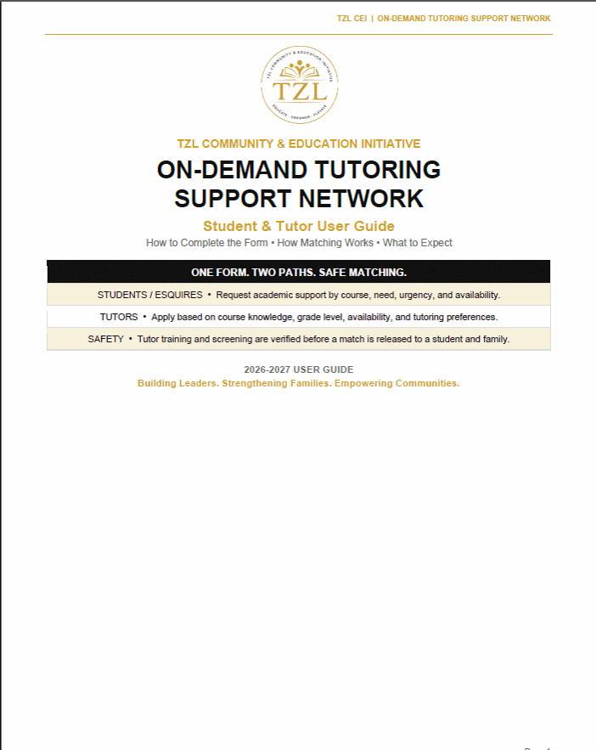
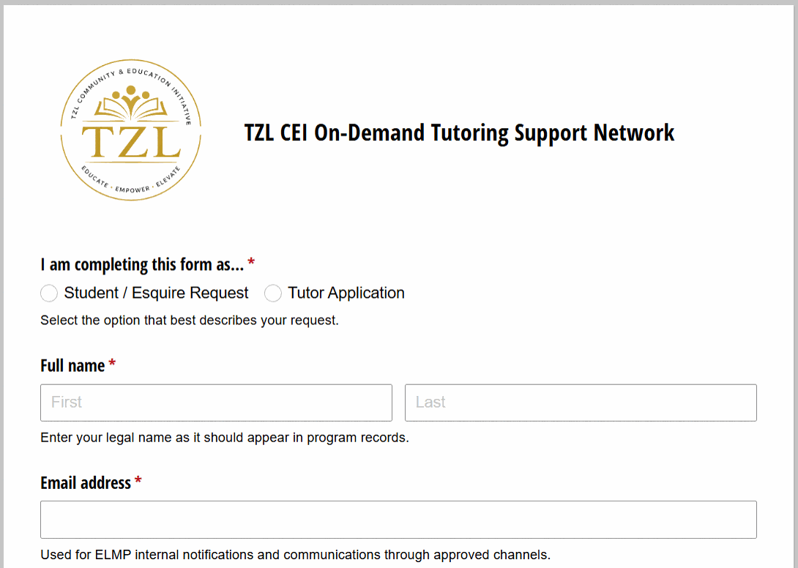
TZL CEI On-Demand Tutoring Support Network
Strategic Planning Meeting | 2026–2027 Program Year
PROGRAM MODEL
LIVE FORM PREVIEW
One form gives Esquires/students a safe way to request academic support and gives tutors a controlled path to apply, while staff manage every release and match.
1
Request or Apply
2
Staff Review
Student or tutor completes the same intake form.
Program staff reviews course need, timing, and capacity.
3
Verify and Match
4
Approved Connection
Training, screening, fit, and availability are checked.
Parent notice and staff release occur before contact.
WHAT STAFF CONTROLS
Academic Fit
Exact course, level, topic, and tutor comfort
Practical Fit
Availability, format, urgency, and tutor capacity
Safety Gate
Mentor training, screening, and no automatic match release
ACCESS
Why It Matters: This system strengthens ELMP academic support through a simple intake process, a verified tutor pool, and a controlled-release model that protects students.
- Students select Student / Esquire Request
- Tutors select Tutor Application
- Program staff reviews before any match is released
Building Leaders. Strengthening Families. Empowering Communities.
One form. Two paths. Safe matching.

Slide 42

POWER OF NINE LITERACY PROJECT
A year-round literacy model with six connected initiatives
The project connects book access, storytelling, family engagement, life literacy, and nonpartisan civic learning across the year.
01
COMMUNITY BOOK DISTRIBUTION
02
CHILDREN'S STORYTELLING
03
MONTHLY READING
Place books in homes through service days, partner sites, school connections, and CEI events.
Trusted readers and volunteers build joy, confidence, vocabulary, and early literacy habits.
Create a consistent rhythm with prompts, youth and family participation, and recognition.
04
BOOK-TO-MOVIE CLUBS
05
FAMILY LIFE LITERACY
06
CIVIC LITERACY
Use books and film discussions to practice comprehension, comparison, reflection, and dialogue.
Build practical reading skills for school forms, finances, health, employment, and technology.
Use plain-language, nonpartisan resources to strengthen informed voice and responsible participation.
ACCESS > READ > DISCUSS > APPLY > SERVE > LEAD
Targets: 12 monthly touchpoints | 6 active initiatives | 3+ partner-hosted activities | 1 year-end impact summary
TZL COMMUNITY & EDUCATION INITIATIVE | 2026-2027
40
Notes:
The D9 Literacy Project is a cross-cutting strategic initiative, not a fourth CEI pillar. It supports youth, families, and civic learning across the three-pillar model.
[Sources]
- TZL CEI Strategic Plan 2026-2027 Presentation Community Benefit Scorecard.pptx (attached)
[/Sources]

Slide 43
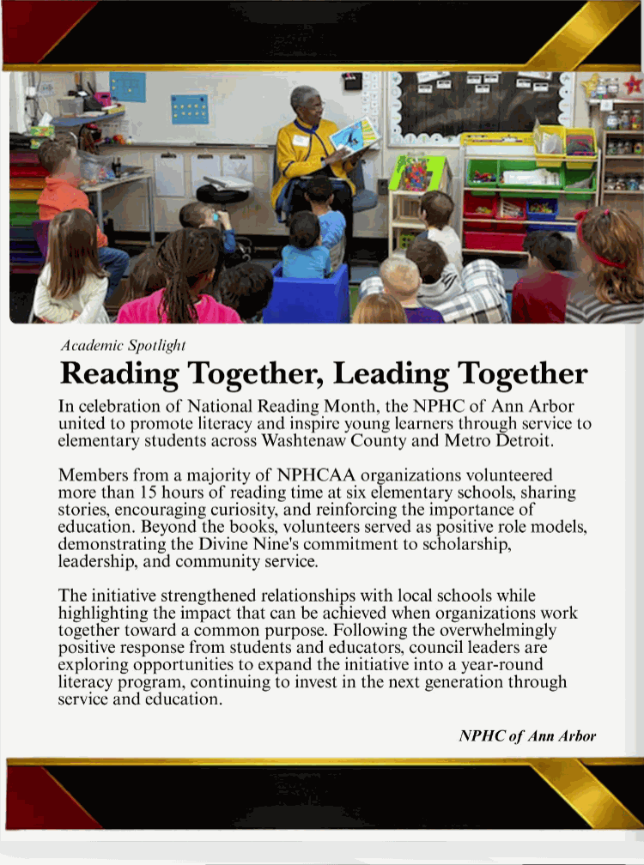
PILLAR 1 | BUILD LEADERS
Power of Nine Literacy: National Recognition
ARTICLE SPOTLIGHT
“Reading Together, Leading Together” spotlighted service, literacy, and Divine Nine unity.
2025-2026 Highlight
First highlighted feature in the Inaugural “Stronger Together” National NPHC Newsletter.
WHAT THE ARTICLE EMPHASIZED
• NPHC of Ann Arbor united Divine Nine organizations during National Reading Month.
• Volunteers provided 15+ reading hours at six elementary schools.
• Showed literacy role models and Divine Nine commitment to scholarship, leadership, and service.
PLANNING TAKEAWAY
Scale this recognition into a year-round literacy model.
TZL COMMUNITY & EDUCATION INITIATIVE | 2026-2027

Slide 44

THE 2026-2027 Calendar
TZL COMMUNITY & EDUCATION INITIATIVE | 2026-2027
PROGRAM YEAR CALENDAR
AUGUST–OCTOBER | Operating Milestones
Launch, partnership, civic voice, and ELMP opening standard.
9 events • 8 confirmed • 1 tentative
Aug 12
●
CEI Board Meeting
Sep 10
●
Empower Civic Symposium
6:00 PM
TZL CEI • Zoom
6:00 PM
TZL Empower • WCC Liberal Arts / College Theater
Aug 27
●
Community Partnership Luncheon
Oct 10
●
ELMP Kickoff: Belonging + Standards
12:00 PM
TZL CEI • Washtenaw Golf Club
11:00 AM
ELMP • WCC Liberal Arts 140
Aug 29
●
Woodlawn Cemetery Restoration
Oct 14
●
CEI Board Meeting
10:00 AM
Caring & Sharing • Woodlawn Cemetery
6:00 PM
TZL CEI • Zoom
Sep 9
●
CEI Board Meeting
Oct 24
○
ELMP Brotherhood Quest – Big Best In Games
6:00 PM
TZL CEI • Zoom
12:00 PM
ELMP • Ypsilanti
Oct 24
●
Community Day
8:00 AM
Caring and Sharing • YCMS?
Launch window: partnership activation, civic learning, and ELMP entry standards.
14
Notes:
Close by asking for approval of the plan, active partnership support, and quarterly monitoring.
[Sources]
- TZL CEI Strategic Plan 2026-2027.docx, Board Decision Standard and Strategic Direction
[/Sources]

Slide 45
THE 2026-2027 BOARD DECISION
TZL COMMUNITY & EDUCATION INITIATIVE | 2026-2027
PROGRAM YEAR CALENDAR
NOVEMBER–DECEMBER | Operating Milestones
Early service, family support, fundraising, and cultural connection.
11 events • 6 confirmed • 5 tentative
Nov 11
●
CEI Board Meeting
Dec 12
●
ELMP AI Responsibility Seminar
6:00 PM
TZL CEI • Zoom
10:00 AM
ELMP • WCC Gunder Myran 319
Nov 14
●
ELMP Skills, Pathways & Service
Dec 19
○
Christmas Food Basket Delivery
10:00 AM
ELMP • WCC Gunder Myran 319
10:00 AM
ELMP / Caring & Sharing • YCMS
Nov 21
●
Family Essentials Kits
Dec 19
○
Avengers Fundraiser
10:00 AM
ELMP / Caring & Sharing • YCMS
1:30 PM
ELMP • Theater and showtime to be confirmed
Nov 21
○
Thanksgiving Food Basket Delivery
Dec 19
○
Jingle Bell Ball / Toys-for-Tots/Adopt-A-Family
10:00 AM
ELMP / Caring & Sharing • YCMS
3:00 PM
Caring & Sharing • Global Tech Academy
Dec 9
●
CEI Board Meeting
Dec 31
●
Kids Kwanzaa + Reading with Black Men Read
6:00 PM
TZL CEI • Zoom
2:00 PM
Caring & Sharing • African American Cultural Historical Museum of Washtenaw County
Dec 12
○
Real Agape Coats Drive
Time TBD
Caring & Sharing • Global Tech Academy
High-volume window: service, family support, fundraising, and cultural connection occur together.
15
Notes:
Close by asking for approval of the plan, active partnership support, and quarterly monitoring.
[Sources]
- TZL CEI Strategic Plan 2026-2027.docx, Board Decision Standard and Strategic Direction
[/Sources]

Slide 46
THE 2026-2027 BOARD DECISION
TZL COMMUNITY & EDUCATION INITIATIVE | 2026-2027
PROGRAM YEAR CALENDAR
JANUARY–MARCH | Operating Milestones
Leadership development, exposure, professional growth, and spring service.
10 events • 8 confirmed • 2 tentative
Jan 9
●
Careers Without Limits
Feb 27
●
Underground Railroad Living Museum
10:00 AM
ELMP • WCC Gunder Myran 319
10:00 AM
ELMP • First Congregational Church, Detroit
Jan 13
●
CEI Board Meeting
Mar 10
●
CEI Board Meeting
6:00 PM
TZL CEI • Zoom
6:00 PM
TZL CEI • Zoom
Jan 16
●
MLK Day Community Event
Mar 13
●
Prepared Minds, Calm Responses
10:00 AM
Caring & Sharing • WCC Morris Lawrence Building?
10:00 AM
ELMP • WCC Gunder Myran 319
Jan 23
●
College Exposure Experience – Chemistry Lab
Mar 27
○
Easter Food Basket Delivery/Senior Connection Kits
10:00 AM
ELMP • WCC Liberal Arts 311
10:00 AM
ELMP / Caring & Sharing • YCMS
Feb 10
○
CEI Board Meeting
6:00 PM
TZL CEI • Zoom
Feb 13
●
Professional Development + Black Leadership
10:00 AM
ELMP • WCC Gunder Myran 319
Mid-year window: review progress, strengthen exposure experiences, and prepare spring service.
16
Notes:
Close by asking for approval of the plan, active partnership support, and quarterly monitoring.
[Sources]
- TZL CEI Strategic Plan 2026-2027.docx, Board Decision Standard and Strategic Direction
[/Sources]

Slide 47
THE 2026-2027 BOARD DECISION
TZL COMMUNITY & EDUCATION INITIATIVE | 2026-2027
PROGRAM YEAR CALENDAR
APRIL–JULY | Operating Milestones
Community voice, recognition, Board closeout, and year-two preparation.
9 events • 8 confirmed • 1 tentative
Apr 10
●
Community Voice + Media Literacy
May 12
●
CEI Board Meeting
10:00 AM
ELMP • WCC Gunder Myran 319
6:00 PM
TZL CEI • Zoom
Apr 14
●
CEI Board Meeting
May 22
●
Student Recognition Dinner
6:00 PM
TZL CEI • Zoom
6:00 PM
ELMP • WCC Morris Lawrence Building
Apr 17
○
Community Day
Jun 9
●
CEI Board Meeting
6:00 PM
Caring and Sharing • Location TBD?
6:00 PM
TZL CEI • Zoom
Apr 24
●
Youth Town Hall or Voting Advocacy Experience
Jul 14
●
CEI Board Meeting
10:00 AM
ELMP / TZL Empower • Town hall location to be confirmed
6:00 PM
TZL CEI • Zoom
May 8
●
Etiquette + Responsible Choices
10:00 AM
ELMP • WCC Gunder Myran 319
Closeout window: community voice, recognition, Board reporting, and next-year approval.
17
Notes:
Close by asking for approval of the plan, active partnership support, and quarterly monitoring.
[Sources]
- TZL CEI Strategic Plan 2026-2027.docx, Board Decision Standard and Strategic Direction
[/Sources]

Slide 48












COMMUNITY SPONSORS AND PARTNERSHIPS
TZL CEI STRATEGIC PLANNING | 2026–2027
Partnerships that strengthen leadership development, family support, and civic empowerment.
Food Gatherers
Aerospace Career Pathways
WISD-CTE
The Real Agape
Eastern Michigan University
Washtenaw Community College
Theta Zeta Lambda Chapter of
Alpha Phi Alpha Fraternity, Inc.
Constellium
DouggieButterHoodz
Big Brothers Big Sisters
Ann Arbor Area
Community Foundation
NPHC Ann Arbor
NAACP Ann Arbor
STRONG PARTNERS. STRONGER TOGETHER.
Working together to build leaders, strengthen families, and empower communities.
MENTOR • SERVE • EMPOWER

Slide 49

UPCOMING STRATEGIC EVENT | TZL CEI • PARTNERSHIPS & RESOURCES
Community Partnership Luncheon
A relationship-building event designed to connect CEI’s mission with people and organizations positioned to expand opportunity and community impact.
DATE
TIME
LOCATION
Thursday
August 27, 2026
12:00 PM – 2:00 PM
Washtenaw Golf Club
2955 Packard Rd • Ypsilanti
EVENT PURPOSE
STRATEGIC CONNECTION
• Bring community leaders, business partners, educators, supporters, and friends together to understand CEI’s three-pillar model.
• Move relationships toward collaboration, sponsorship, in-kind support, introductions, and long-term partnership.
• Serves as a launch point for the CEI partnership and resource strategy.
• Supports ELMP, Caring & Sharing, TZL Empower, and cross-pillar sustainability.
WHAT WE NEED FROM BROTHERS
• Invite decision-makers and prospective partners who can contribute time, expertise, resources, or relationships.
• Attend as CEI ambassadors and make purposeful introductions.
• Follow up so interest becomes an owned next action.
SCORECARD CONNECTION
Annual goals: 12 active CEI partnerships | 2+ partners supporting each pillar | $30,000 combined cash support / sponsorships
TZL COMMUNITY & EDUCATION INITIATIVE | 2026–2027
UPCOMING STRATEGIC EVENT

Slide 50

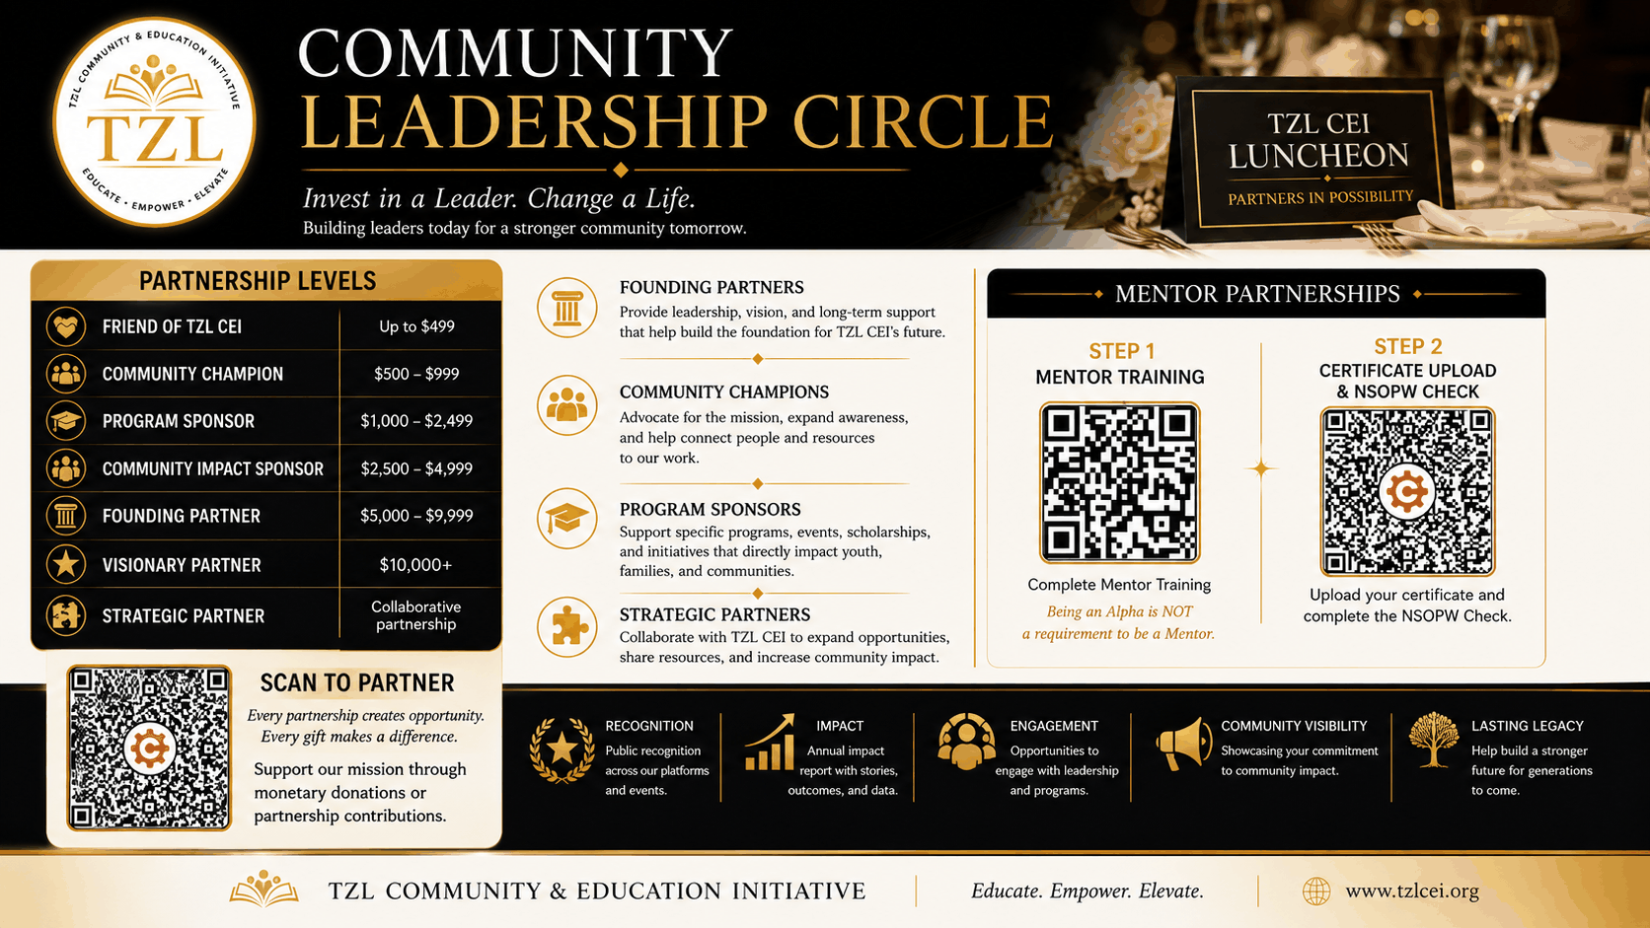
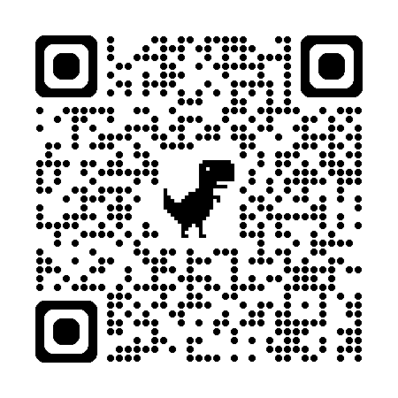
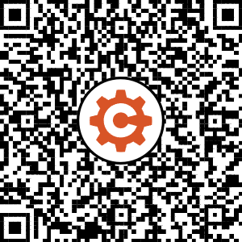
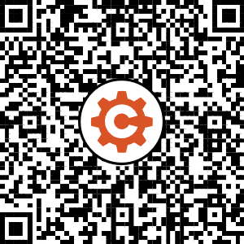
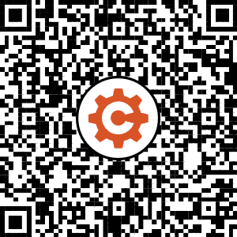

Slide 51


UPCOMING STRATEGIC EVENT | PILLAR 2 • STRENGTHEN FAMILIES
Woodlawn Cemetery Restoration Project
A hands-on service experience that preserves community history, honors those who came before us, and turns Caring & Sharing values into visible collective action.
DATE
TIME
LOCATION
Saturday
August 29, 2026
10:00 AM – 3:00 PM
Woodlawn Cemetery
7800 S. Huron River Drive • Ypsilanti
EVENT PURPOSE
STRATEGIC CONNECTION
• Mobilize Brothers and volunteers for restoration and clearing work that supports the cemetery’s long-term preservation.
• Connect service, history, teamwork, and community stewardship through a meaningful local project.
• Strengthens Caring & Sharing’s year-round service model beyond seasonal distributions.
• Creates a practical opportunity for volunteer activation, community partnership, intergenerational service, and documented impact.
WHAT WE NEED FROM BROTHERS
• Volunteer for the workday and recruit additional capable volunteers.
• Bring appropriate wheelbarrows, heavy-duty carts, saws, or other useful cutting and clearing tools.
• Document service hours, completed work, needs, and follow-up for CEI impact reporting.
SCORECARD CONNECTION
Track: volunteers | service hours | equipment mobilized | work completed | partner coordination | follow-up actions
TZL COMMUNITY & EDUCATION INITIATIVE | 2026–2027
UPCOMING STRATEGIC EVENT

Slide 52

UPCOMING STRATEGIC EVENT | PILLAR 3 • EMPOWER COMMUNITIES
TZL Empower Civic Education Symposium
A major 2026–2027 civic-engagement anchor connecting trustworthy information, community voice, and informed participation.
DATE
TIME
LOCATION
Thursday
September 10, 2026
6:00 PM – 8:00 PM
WCC Liberal Arts Building
College Theater • Room 140
EVENT PURPOSE
STRATEGIC CONNECTION
• Provide a free, nonpartisan forum where residents can understand how local and state decisions affect everyday life.
• Create respectful access to public leaders, verified civic information, and practical pathways to participation.
• Implements A Voteless People Is a Hopeless People through TZL Empower.
• Supports the annual Empower goals for civic education, evaluation, volunteer development, and community trust.
WHAT WE NEED FROM BROTHERS
• Invite residents, community partners, and neighborhood leaders.
• Volunteer for welcome, registration, logistics, resource distribution, and follow-up.
• Help protect a factual, respectful, nonpartisan event standard.
SCORECARD CONNECTION
100 attendees | 75 civic-resource recipients | 60 evaluations | 80% increased understanding | 10 prospective volunteers
TZL COMMUNITY & EDUCATION INITIATIVE | 2026–2027
UPCOMING STRATEGIC EVENT
Notes:
The Symposium should help residents understand how public decisions affect everyday life. Final public materials require verification of dates, offices, resources, logos, links, nonpartisan language, and accessibility.
[Sources]
- TZL_Empower_2026-2027_Information_Packet(1).pdf (attached)
- https://tzlempower.org/
[/Sources]

Slide 53
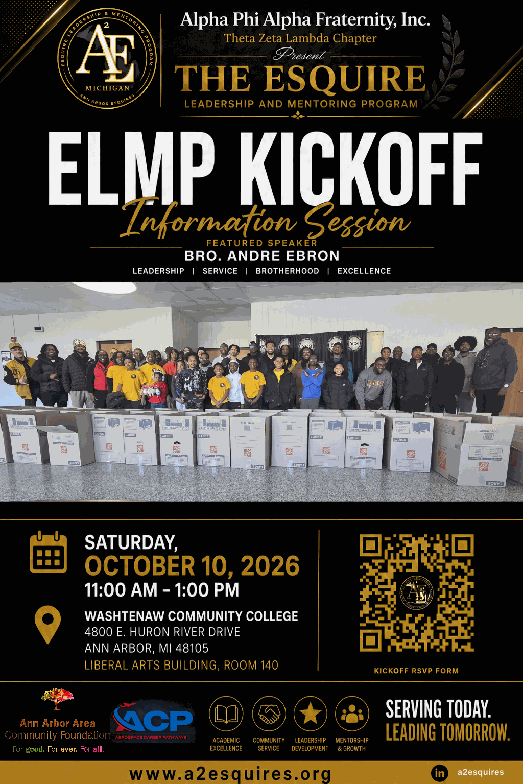
UPCOMING STRATEGIC EVENT | PILLAR 1 • BUILD LEADERS
ELMP Kickoff Information Session
The opening experience for the 2026–2027 Esquire year—setting expectations, building belonging, and connecting families, Esquires, mentors, and Brothers to one program standard.
DATE
TIME
LOCATION
Saturday
October 10, 2026
11:00 AM – 1:00 PM
Washtenaw Community College
Liberal Arts Building • Room 140
EVENT PURPOSE
STRATEGIC CONNECTION
• Welcome the 2026–2027 Esquire class and introduce the leadership, service, Brotherhood, and excellence expectations that guide the year.
• Feature Bro. Andre Ebron while orienting families and participants to the program journey and next steps.
• Launches ELMP’s eight-month leadership pathway and standardized Success Seminar model.
• Connects enrollment, family engagement, mentoring support, Success Goals, service, and recognition from the beginning.
WHAT WE NEED FROM BROTHERS
• Be present to welcome Esquires and families and model Brotherhood.
• Support registration, hospitality, mentor/facilitator connection, and program orientation.
• Help families leave knowing the schedule, expectations, support resources, and next action.
SCORECARD CONNECTION
Program-year targets: 40 enrolled | 36 active through May | 90% retention | consistent family and approved-adult engagement
TZL COMMUNITY & EDUCATION INITIATIVE | 2026–2027
UPCOMING STRATEGIC EVENT

Slide 54
THE 2026-2027 COMMITMENT
One mission. Three pillars. Shared accountability.
When Brothers, programs, families, and partners work as one system, community impact becomes understandable, measurable, and sustainable.
BUILD LEADERS
STRENGTHEN FAMILIES
EMPOWER COMMUNITIES
Support 40 Esquires through safe mentoring, academic and college/career readiness, leadership development, and age-appropriate national program implementation.
www.a2esquires.org
Deliver dignified care, operate Senior Connection / Brother's Keeper, protect proven seasonal reach, and respond to identified needs.
www.tzlcaringsharing.org
Deliver accurate, nonpartisan VPHP-aligned civic education and turn community learning into responsible participation.
www.tzlempower.org
UNDERSTAND > COMMIT > SERVE > DOCUMENT > IMPROVE
TZL COMMUNITY & EDUCATION INITIATIVE | 2026-2027
46
Notes:
Close by returning to the central idea: CEI is one connected system. Invite focused discussion on ownership, resourcing, calendar readiness, and any target that needs adjustment before approval.
[Sources]
- TZL CEI Strategic Plan 2026-2027 Presentation Community Benefit Scorecard.pptx (attached)
- Version 6 ELMP Information Packet(1).pdf (attached)
- Caring_and_Sharing_2026-2027_Information_Packet.pdf (attached)
- TZL_Empower_2026-2027_Information_Packet(1).pdf (attached)
- https://tzlcei.org/
[/Sources]

